Slide 1
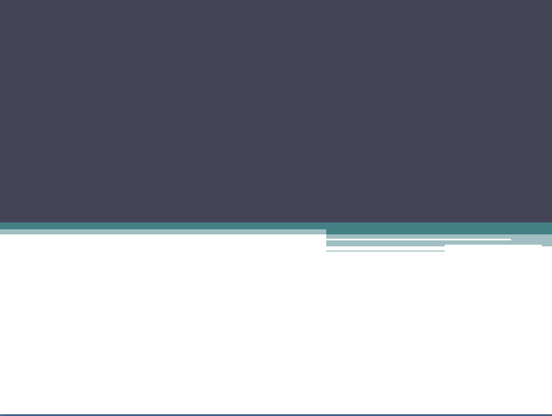
Group – B
Team:
Ankit
Kumar Shaw
Suparno
Chakraborty
Akash
Shah
Sunanda
Sarkar

Slide 2



Slide 3

About the Page
The website offers a one stop solution to online book shopping.
The website provides a whole array of books for purchase by the user.
A section of free public domain and other books will be available for the registered user to download and read.
A built-in e-book reader will be provided by the website and made available to the user to read the purchased books from their profile list and the user can also read books that are already present in their system by uploading directly to the e-book interface from their computer.
There is a user authentication system present and the user will have to register and create a free account for purchases and for using the e-book reader.

Slide 4


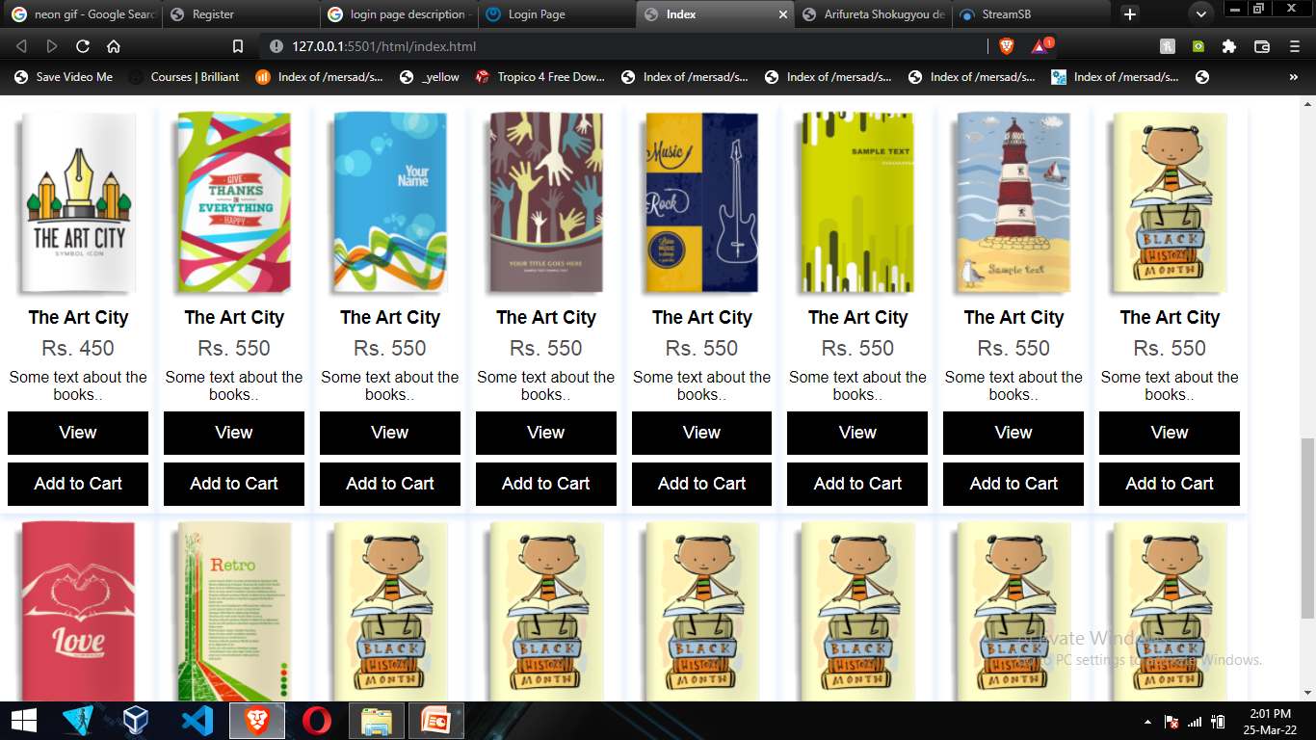
Home pAGE

Slide 5
Home pAGE
Home page: It is the landing page where the user first visits the website.
Here in this page, the website shows array of books for purchase by the user.
A section of free public domain and other books will be available for the registered user to download and read.
A built-in e-book reader will be provided by the website and made available to the user to read the purchased books from their profile list.
There is a user authentication system present and the user will have to register and create a free account for purchases and for using the e-book reader.
In this home page, header contains project logo and a GIF.
After, navigation bar contains home, featured, arrivals, reviews including login/register button and a search bar.
After, side menu bar contains some book categories like- thriller, comedy, romance, fiction, horror kids etc.

Slide 6
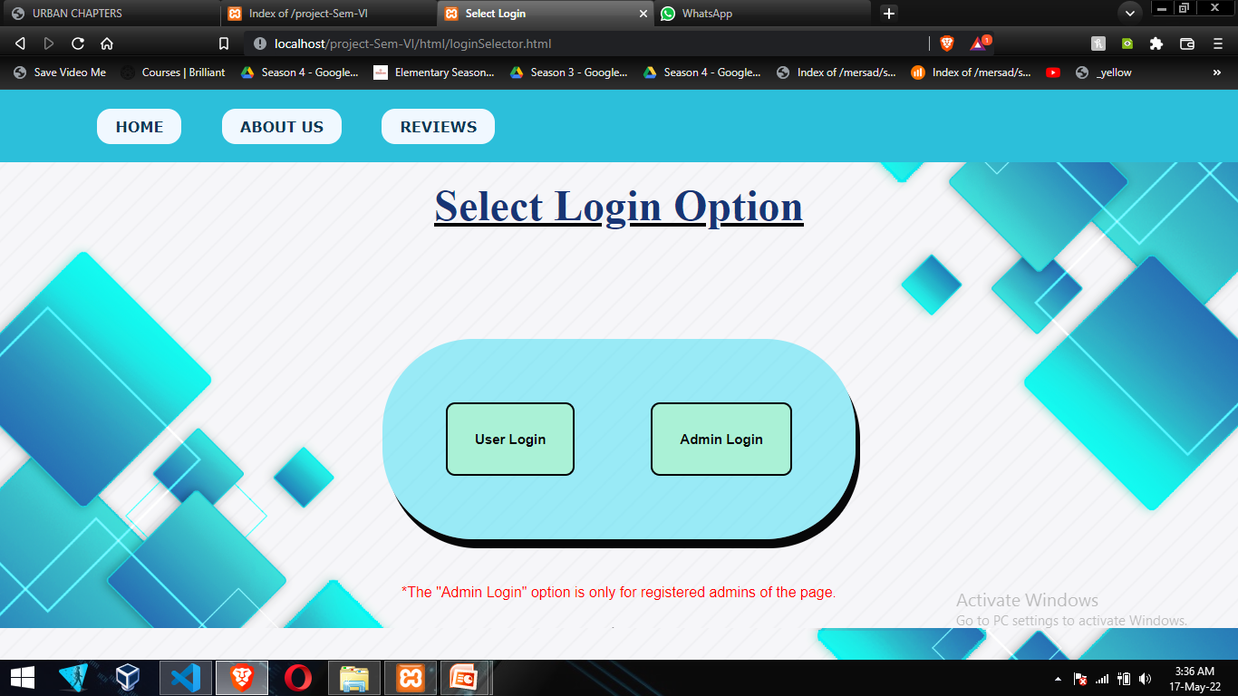
Login Select pAGE
The login selector page the user needs to choose between user login or admin login.
Note* - the admin login is reserved for the registered admins only.

Slide 7
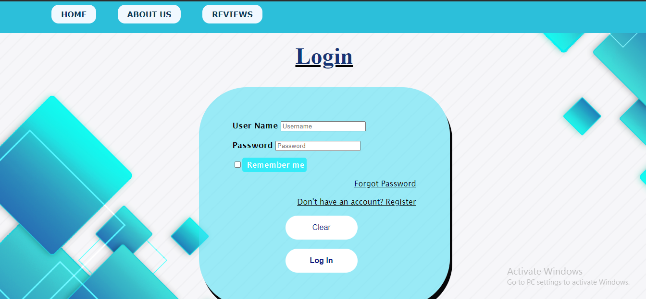
User Login pAGE
If the user chooses the User Login the page will be redirected to the User Login Page.
The user needs to provide its username created during registration

Slide 8
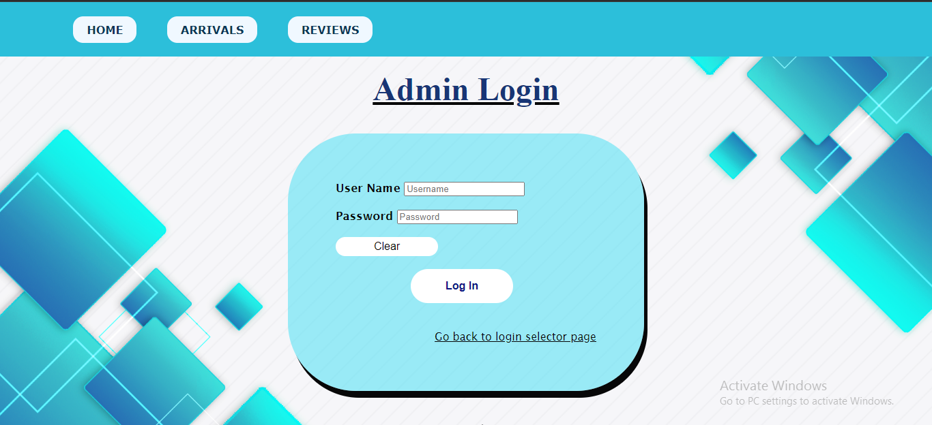
Admin Login pAGE
If the user chooses the Admin Login the page will be redirected to the Admin Login Page.
The user needs to provide its username and passkey.
There is also an option of “Go back to login selector page” in case the user selects the wrong option.

Slide 9
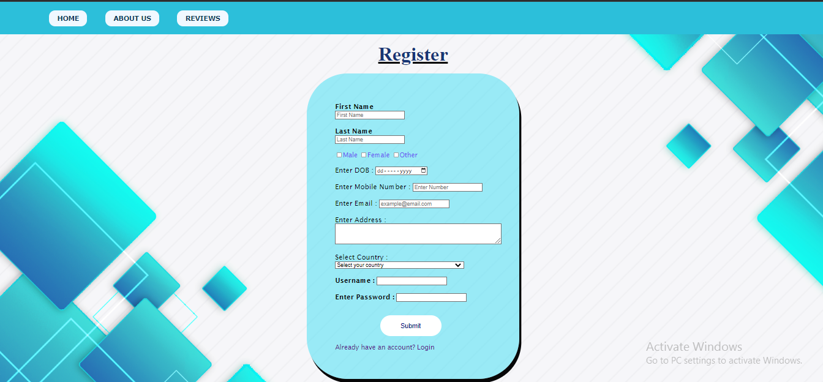
Registration pAGE
Register page allows to create an account for the user.
Field Requirements
first name
last name
gender check
date of birth
mobile number
Email
address
password

Slide 10
Product View pAGE
Product view page shows the details of the selected product(book).
It is accessed by clicking the “View” button or on the product thumbnail.

Slide 11
Payment pAGE
Payment page : Allows the user to buy books with different types of payments methods.
Field Requirements:
Full Name
Email
Address
City
State
Zip code
Name on card
Card no
Expiry month
Expiry date
CVV

Slide 12
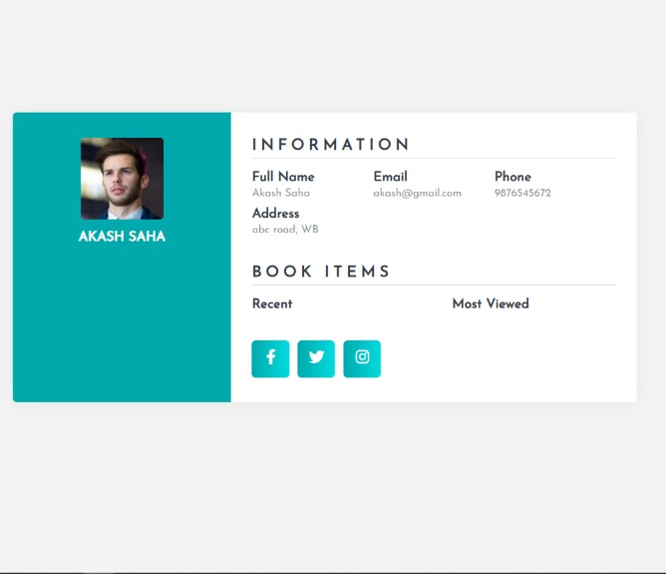
USER Profile pAGE
User Profile Page allows user to store all his/her personal information and to check all his/her activities.
This page contains the photo and name of the user and information like full name, email, phone number, address and also book items which shows user to see his/her recent books and most viewed items.

Slide 13
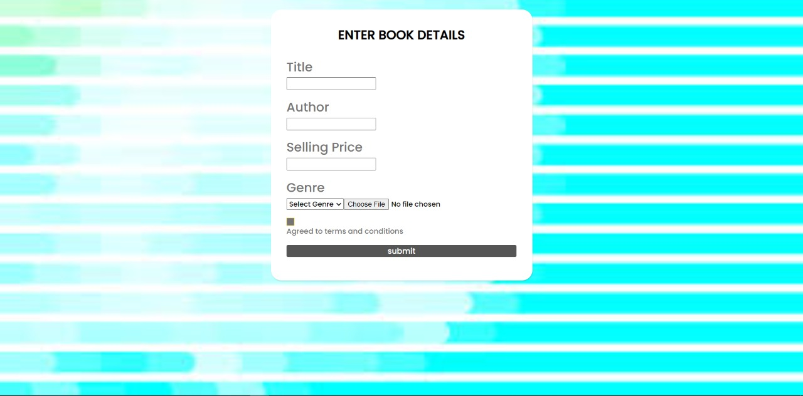
PUBLISHER pAGE
Publisher page
Publisher page allows the publisher to submit books.
In this page, it contains
Title name
Author name
Selling price
Genre
File upload option
Terms-conditions button

Slide 14
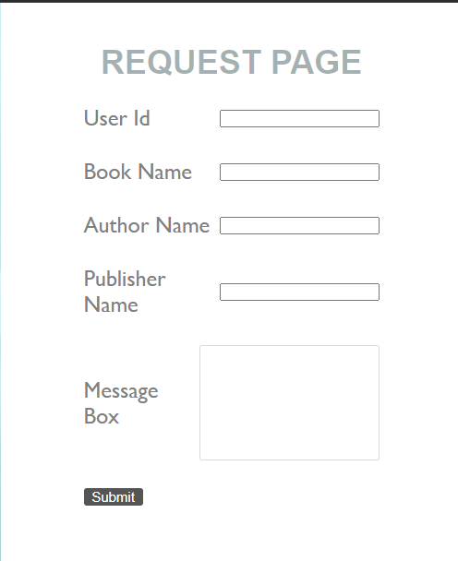
REQUEST pAGE
Request page: Allows the user to request for the books they want to read if those books are not available in our store by given the book name with author name and publisher name.
It can be accessed using the footer of the Home page and shop page.
Field Requirements-
User ID
Book name
Author name
Publisher name
Message box

Slide 15
REVIEW pAGE
Review page
This page contains reviews form customers and users in general.
This page provides a star ranking system as well as a text message system for the users to give feedback in detail.

Slide 16
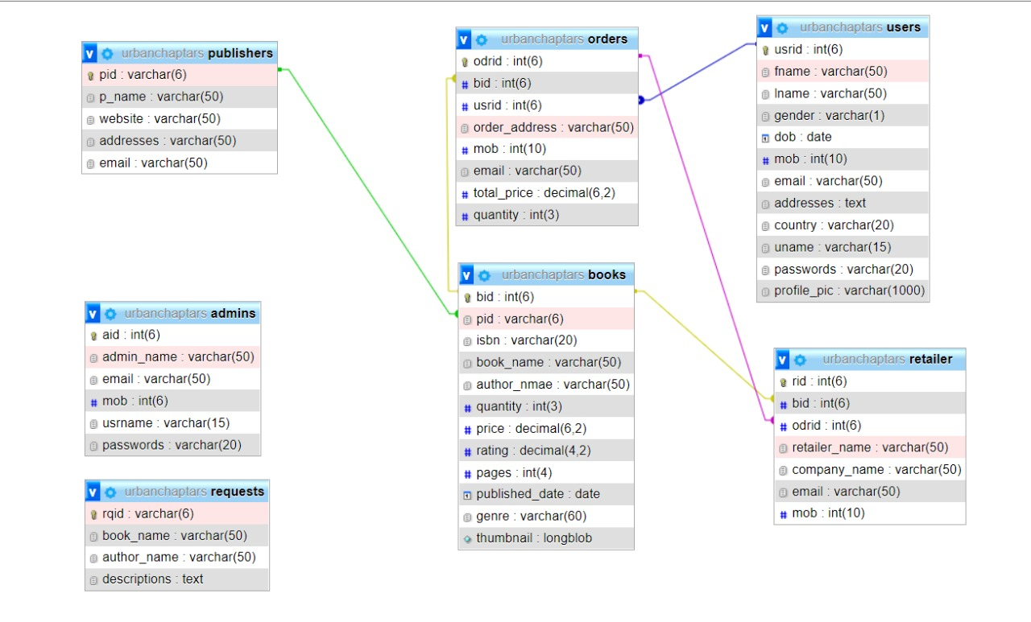
DATABASE

Slide 17

USER TABLE
users
usrid : int(6)
fname : varchar(50)
lname : varchar(50)
gender : varchar(1)
dob : date
mob : int(10)
email : varchar(50)
addresses : text
country : varchar(20)
uname : varchar(15)
password : varchar(20)
profile_pic : varchar(1000)

Slide 18
PUBLISHER TABLE
publishers
pid : varchar(6)
p_name : varchar(50)
website : varchar(50)
addresses : varchar(50)
email : varchar(50)

Slide 19
BOOK TABLE
books
bid : int(6)
pid : varchar(6)
isbn : varchar(20)
book_name : varchar(50)
author_name : varchar(50)
quantity : int(3)
price : decimal(6.2)
rating : decimal(4.2)
pages : int(4)
published_date : date
genre : varchar(60)
thumbnail : longblob

Slide 20
REQUEST TABLE
requests
rqid : varchar(6)
book_name : varchar(50)
author_name: varchar(50)
descriptions : text

Slide 21
ORDER TABLE
orders
odrid : int(6)
bid : int(6)
usrid : int(6)
order_address : varchar(50)
mob : int(10)
email : varchar(50)
total_price : decimal(6.2)
quantity : int(3)

Slide 22
RETAILER TABLE
retailer
rid : int(6)
bid : int(6)
orid : int(6)
retailer_name : varchar(50)
company_name : varchar(50)
email : varchar(50)
mob : int(10)

Slide 23
ADMIN TABLE
admins
aid : int(6)
admin_name : varchar(50)
email : varchar(50)
mob : int(6)
usrname : varchar(15)
password : varchar(20)

Slide 24


